Slide 1

Good code

Slide 2

Good code
Why do we need good code?
Clear code

Slide 3

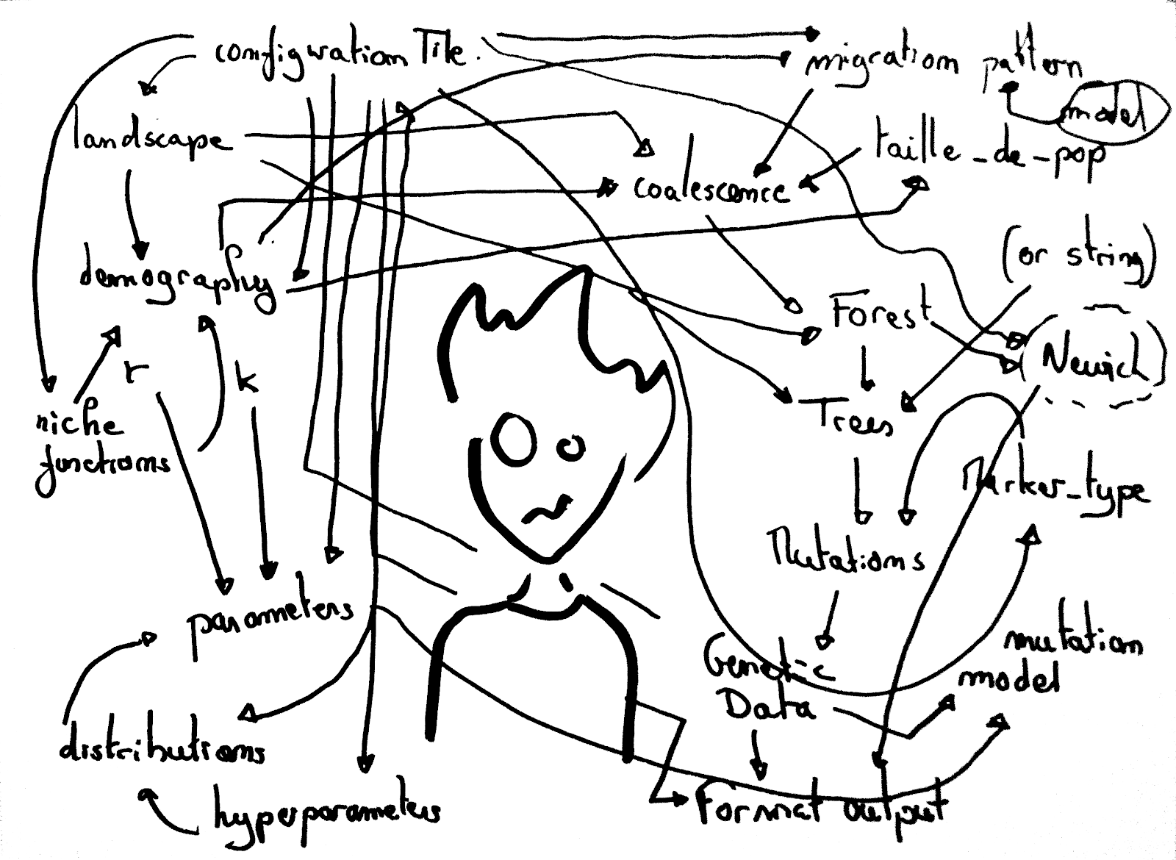
Good code: why do we need it?
How To Avoid Spaghetti Code
https://tech.zensurance.com/posts/spaghetti-code

Slide 4
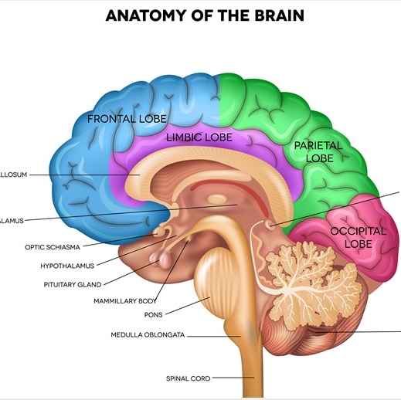
Limitation of the brain
Our brain is being stressed when following long flows of logic
We should help by making the code clearer and “natural.”
Some developers have better capabilities to follow the logic and remember it, but we don’t want to overfill our brain with unnecessary load

Slide 5
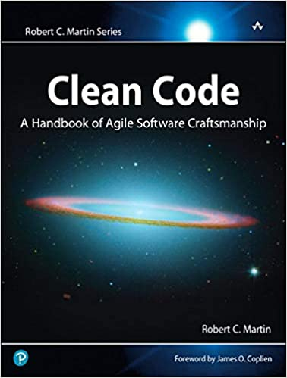

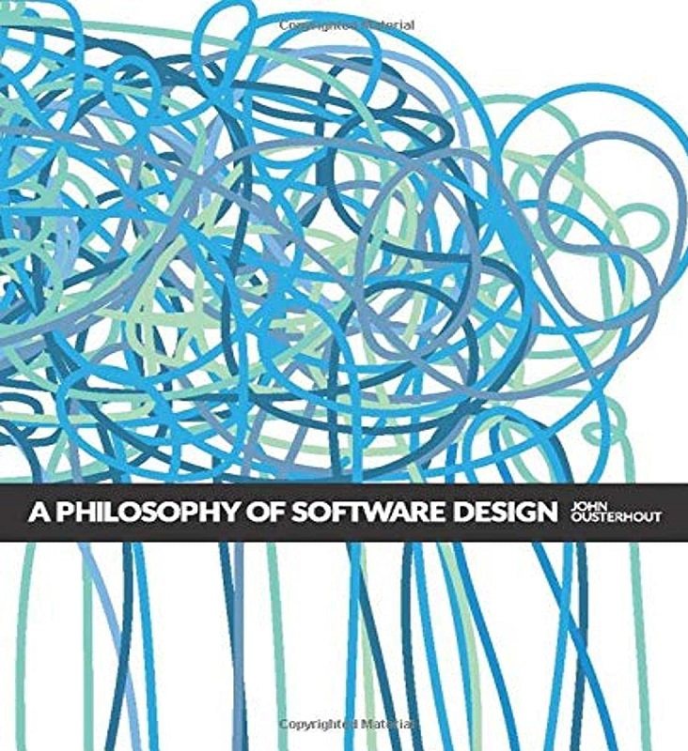
Litreture
John Ousterhout

Slide 6
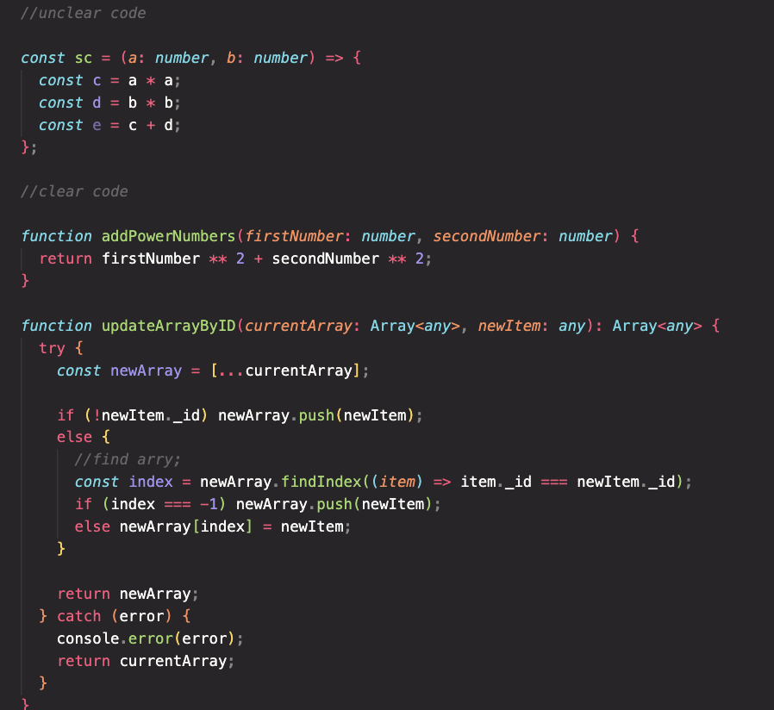
Clear code

Slide 7
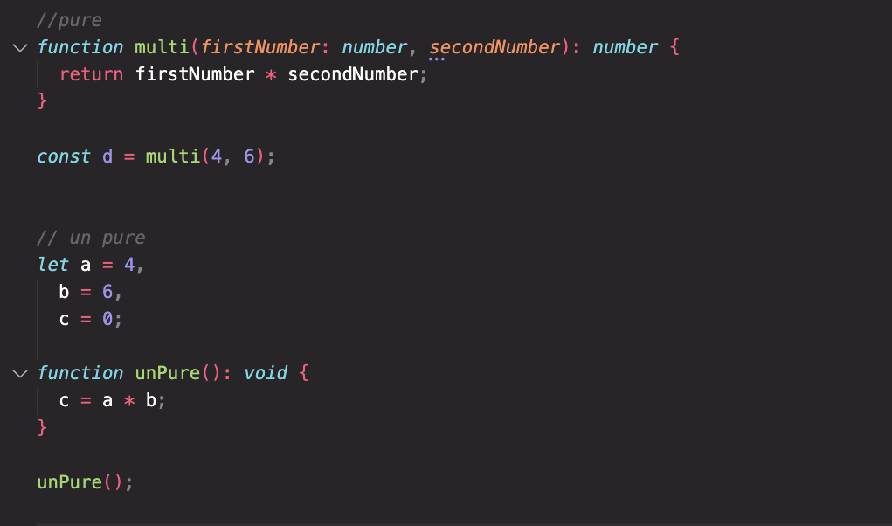
Pure functions
Predictable
Easy to test

Slide 8
SOLID prinipels
Goal
Tolorate change
Easy to understand
The basis of components, that can be used in many software systems
Maintainable

Slide 9

Solid (Uncle Bob)
Single Responsibly Principle
Open Closed Principle
Liskov Substation principle
Interfce segragation principle
Dependency Inversion principle

Slide 10
Single Responsibilty Principle
A function should do one and only one thing
A module should be responsible for one and only one actor (Uncle Bob)

Slide 11
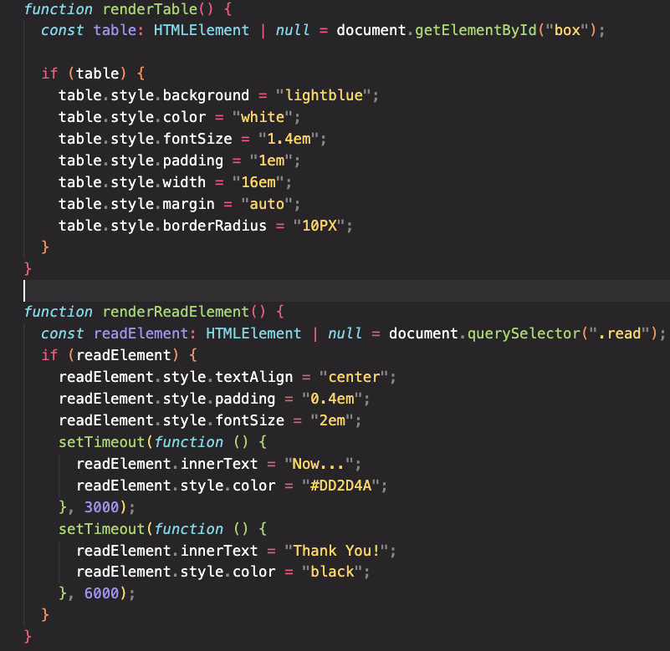
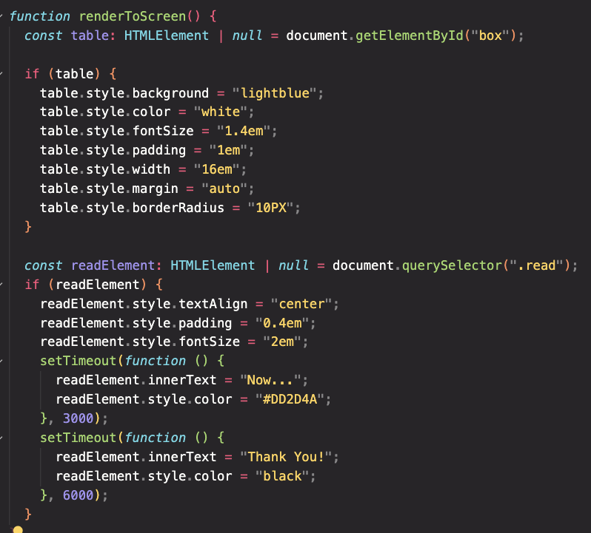
SRP: A function should do one and only one thing

Slide 12
SRP: A function should do one and only one thing
Clearer
Predictable
Testable
Improvable

Slide 13
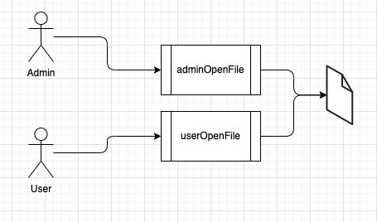
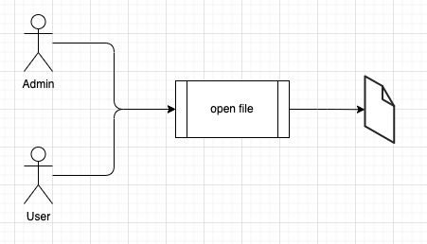
SRP:A module should be responsible for one and only one actor

Slide 14
SRP:A module should be responsible for one and only one actor
We can react to changing concerns of each actor, without the need to decouple

Slide 15
Open Close Principle
When you change, don’t modify existing function, but add new one.

Slide 16
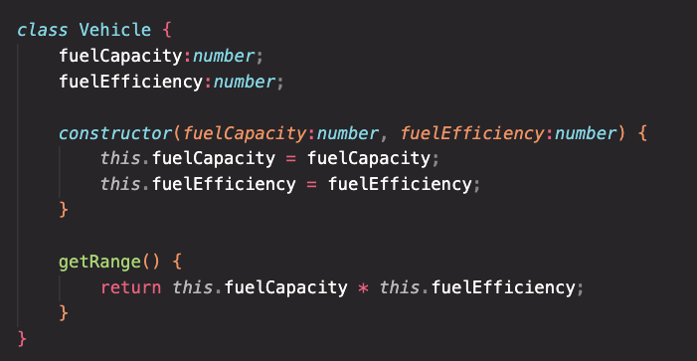
Open Close Principle
When you change, don’t modify existing function, but add new one.

Slide 17
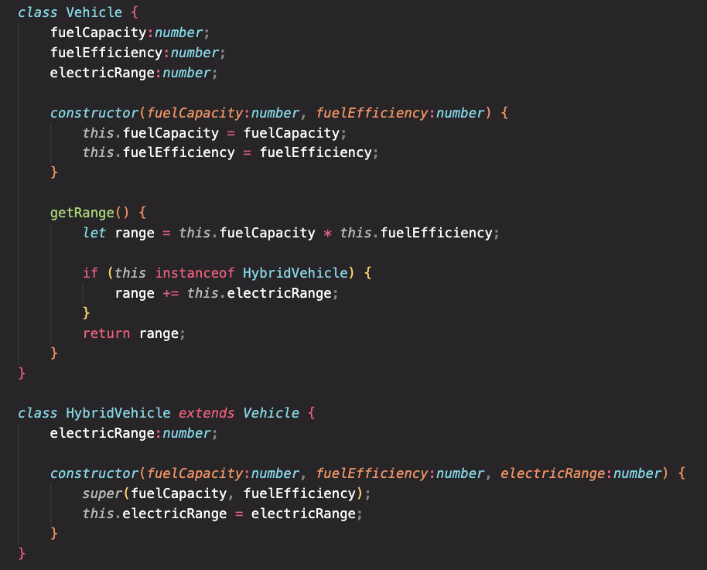
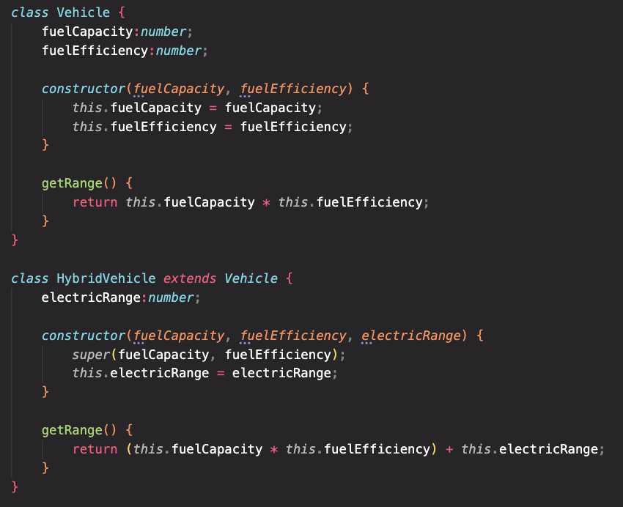
OCP

Slide 18
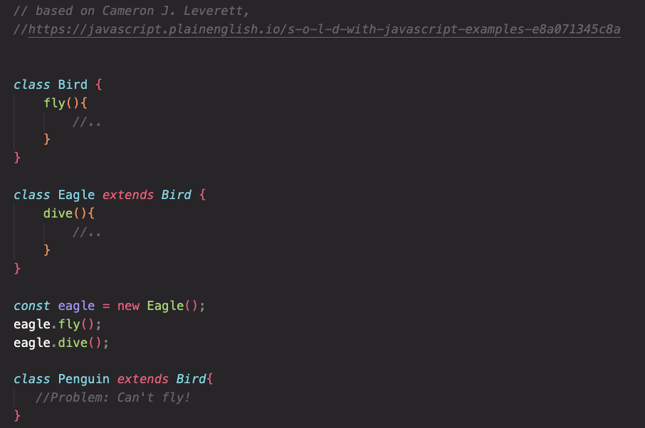
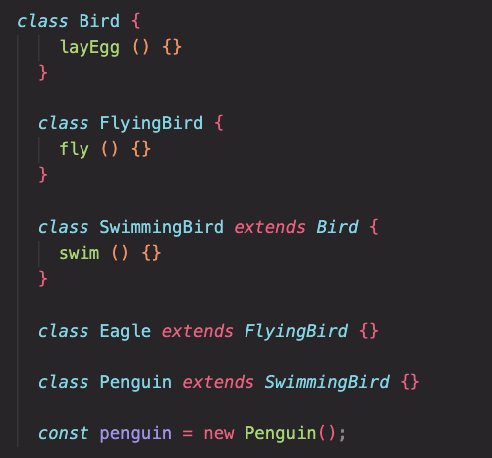
Liskov Substation principle
If you use classes, and you need to rearange, rearange the classes in a way that will not create complexity (My free interpetation).

Slide 19
interface segragation
Not relevent to JS

Slide 20
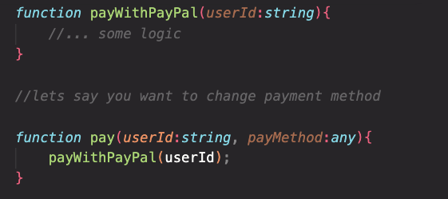
Dependency Inversion
Decouple specific functions, and create more abstract functions

Slide 21
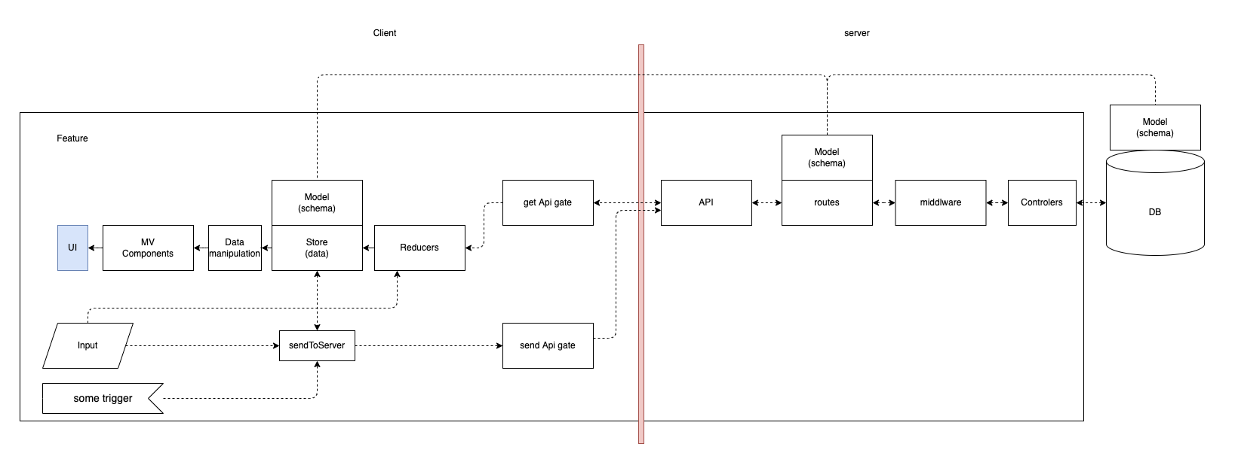
Architecture
https://app.diagrams.net/#G1GXNsbXpbq37vNehycy5LugD57Mus8hgu

Slide 22
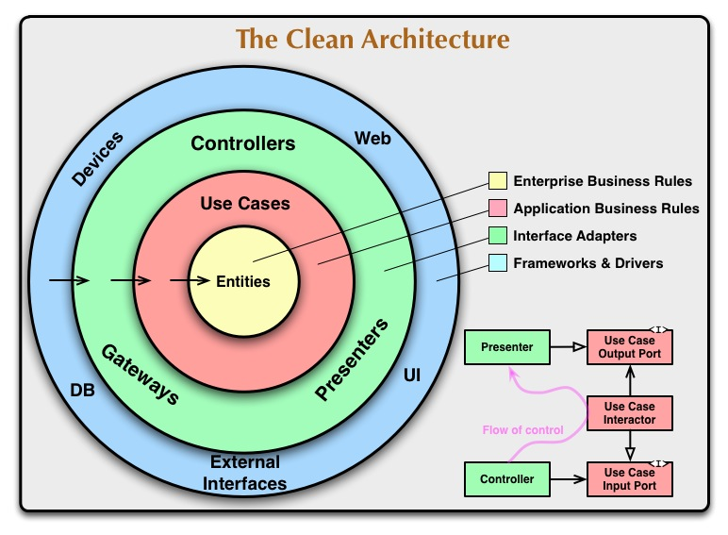

Slide 23

תרגיל פשוט

